Slide 1
Advanced Data Structures

Slide 2
Resources
eBook
Hard Copy book
Visualizing Code tool
Cheat Sheets
*Control click to go to the link.

Slide 3
By now you should
Understand basic data types (strings, numbers, Booleans)
Be able to output data to console using print statements
Be able to retrieve input from users using input command and store as variable
Be able to complete basic mathematical operations
Be able to run conditional statements (if statements)
Be familiar with common string operations (len, upper, lower)

Slide 4
Review Exercise
Create a program for a restaurant that stores each menu item in a separate variable:
item1 = Greek Salad
item2 = Tomato Soup
Item3 = Crabcakes
Item4 = Hot Fudge Sundae
Print the message “Hello, today special is Greek Salad, Tomato Soup, Crabcake, Hot fudge Sundae”
Hint: use f-string

Slide 5
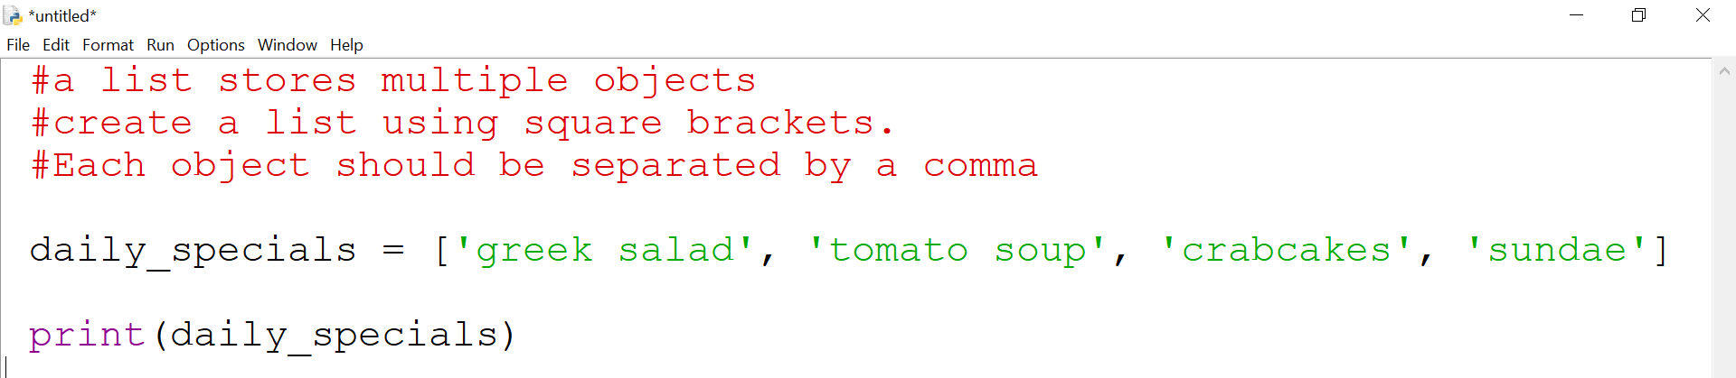
Lists
While variables can store one value at a time, lists can store many values
When naming lists, follow the same naming conventions as naming variables except it is best practice to name lists in the plural (cars, groceries, students)
Lists are mutable meaning they can be changed after they are created
Values in a list do not need to be unique

Slide 6
What can Lists store?
Lists can store any object
Objects in python include strings, integers, lists, and other data structures

Slide 7
Accessing parts of a list
To access an individual index, pass the index number
daily_specials[1]
Index 1 is the second object in the list
To access a multiple items, use
daily_specials[1:3]
This only targets index 1, index 2 and exclude index 3
To access everything after index 1, use daily_special[1:] This target index 1 up to and including the last index

Slide 8
Adding & Removing Data in a list
Syntax | Description
daily_specials.append(‘pasta’) | Adds value ‘pasta’ to the end of the list
daily_specials.insert(4, “pasta”) | Inserts value ‘pasta’ in index 4
daily_specials.remove(“pasta”) | Removes first instance of pasta it finds. Will return a value error if you try deleting something that does not exist
daily_specials.clear() | Removes everything inside the list
daily_specials.pop(1) | Removes index 1 from list . If no arguments are passed it will remove the last index. The value is returned case you want to use it for something else (such as store it in a variable)

Slide 9
Retrieving Data from a list
Syntax | Description | Output
“Sundae” in daily_specials | Checks if a value is in a list | True
“Sundae” not in daily_specials | Checks if value is not in a list | False
len(daily_specials) | Prints count of values in list | 3
daily_specials[2] | Access index 2 or the third value in the list. If you enter a value a greater than the highest index, you will get an index error | Crabcakes
sorted(daily_specials) | Sorts list in alphabetical order | Crabcakes Greek Salad Sundae Tomato Soup

Slide 10
Loops and Iterations
There are 2 types of loops: while loops and for loops
A loop is a way of having your code repeat
Just like conditional statements (aka if statements), a loop will only execute when the condition evaluates to True. Once the loop evaluates to False, the loop is exited
A loop that never becomes False is known as an infinite loop

Slide 11
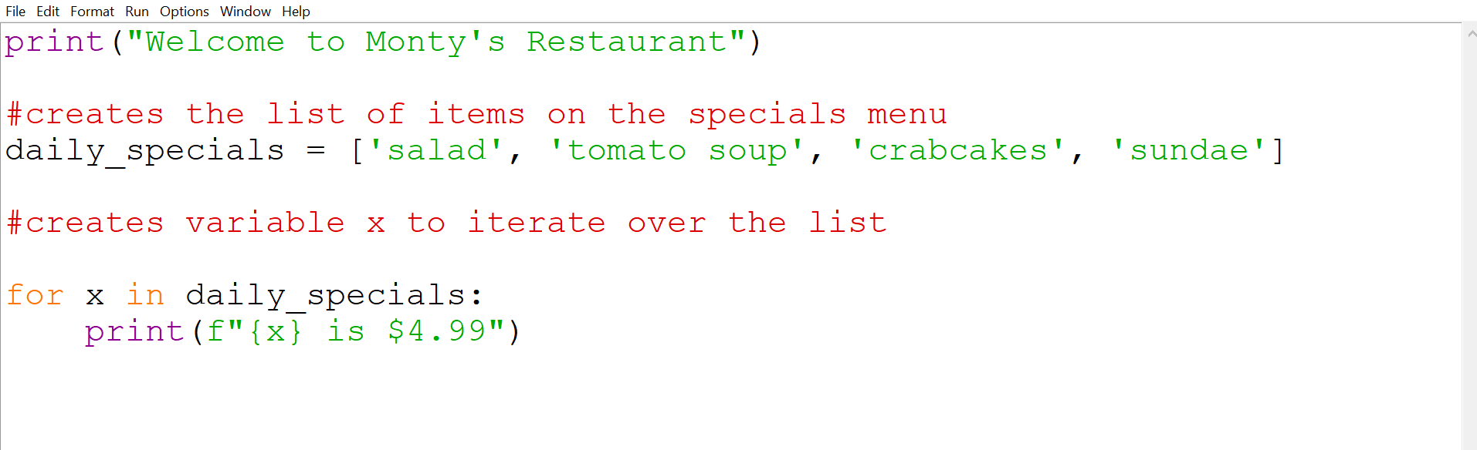
For Loops to iterate over a list
Notes:
print("Welcome to Monty's Restaurant")
#creates the list of items on the specials menu
daily_specials = ['salad', 'tomato soup', 'crabcakes', 'sundae']
#creates variable x to iterate over the list
for x in daily_specials:
print(f"{x} is $4.99")

Slide 12
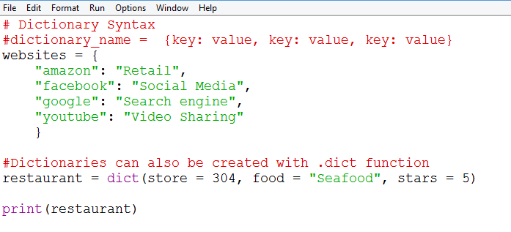
Creating a dictionary
Notes:
# Dictionary Syntax
#dictionary_name = {key: value, key: value, key: value}
websites = {
"amazon": "Retail",
"facebook": "Social Media",
"google": "Search engine",
"youtube": "Video Sharing"
}
#Dictionaries can also be created with .dict function
restaurant = dict(store = 304, food = "Seafood", stars = 5)
print(restaurant)

Slide 13
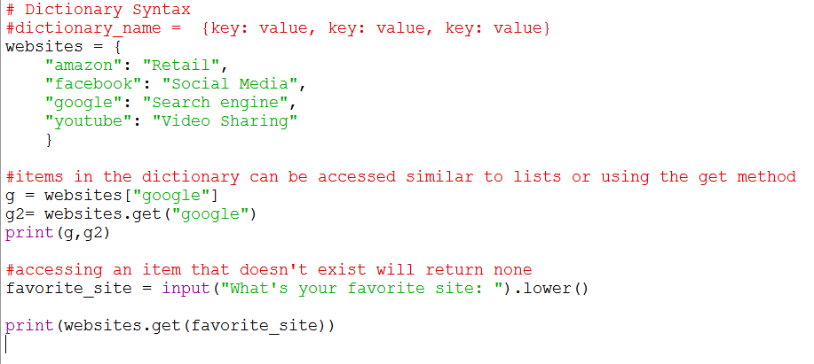
Accessing data in a dictionary
Notes:
# Dictionary Syntax
#dictionary_name = {key: value, key: value, key: value}
websites = {
"amazon": "Retail",
"facebook": "Social Media",
"google": "Search engine",
"youtube": "Video Sharing"
}
#items in the dictionary can be accessed similar to lists or using the get method
g = websites["google"]
g2= websites.get("google")
print(g,g2)
#accessing an item that doesn't exist will return none
favorite_site = input("What's your favorite site: ").lower()
print(websites.get(favorite_site))

Slide 14
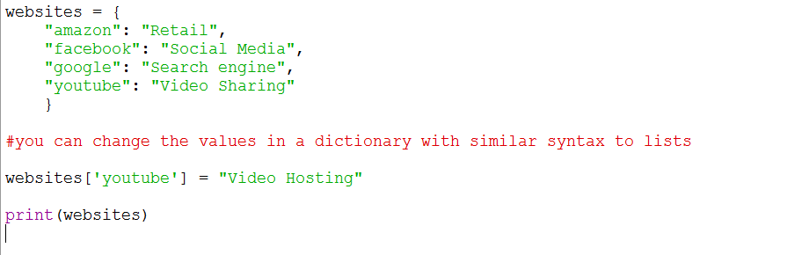
Updating data in a dictionary

Slide 15
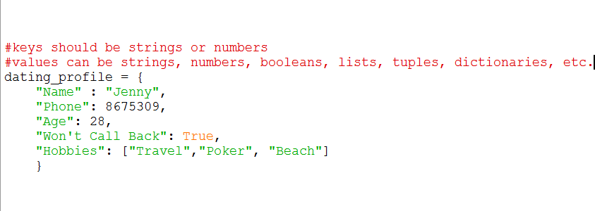
What can I put in a dictionary?
Notes:
#Syntax: open and close dictionary with curly bracket
#enter key on the left, value on the right separated by a colon
#each key value pair is separated by a comma
websites = {
"amazon": "Retail",
"facebook": "Social Media",
"google": "Search engine",
"youtube": "Video Sharing"
}
#dictionary values can be strings, numbers, booleans, lists, tuples
grades = {
"Jane" : 90,
"Emily": 83,
"Sam": 80,
"Ben":88
}

Slide 16

Sets
Sets are a light weight data structure with similarities to lists and dictionaries
They are unordered comma separated items that don’t allow for duplicate entries.
They are most often used for membership testing and removing duplicates
Membership operators are in or not in
See set methods in python documentation, cheat sheets, or other resources

Slide 17
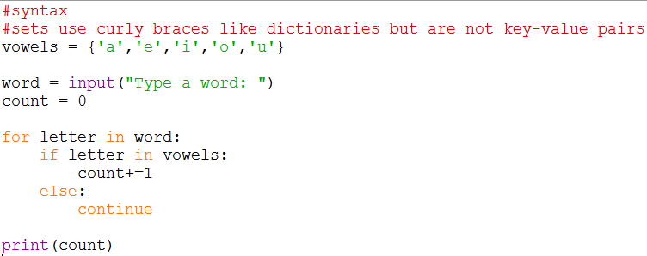
Sets for membership testing
They are most often used for membership testing and removing duplicates
Below program counts number of vowels in a word.
Notes:
#syntax
#sets use curly braces like dictionaries but are not key-value pairs
vowels = {'a','e','i','o','u'}
word = input("Type a word: ")
count = 0
for letter in word:
if letter in vowels:
count+=1
else:
continue
print(count)

Slide 18
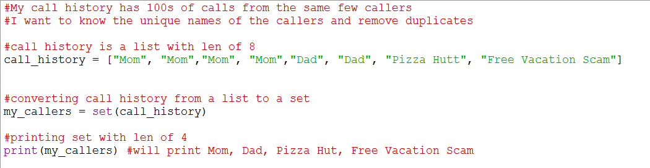
Sets for Removing duplicates
They are most often used for membership testing and removing duplicates
Below program removes duplicates in a list
Notes:
#My call history has 100s of calls from the same few callers
#I want to know the unique names of the callers and remove duplicates
#call history is a list with len of 8
call_history = ["Mom", "Mom","Mom", "Mom","Dad", "Dad", "Pizza Hutt", "Free Vacation Scam"]
#converting call history from a list to a set
my_callers = set(call_history)
#printing set with len of 4
print(my_callers)

Slide 19
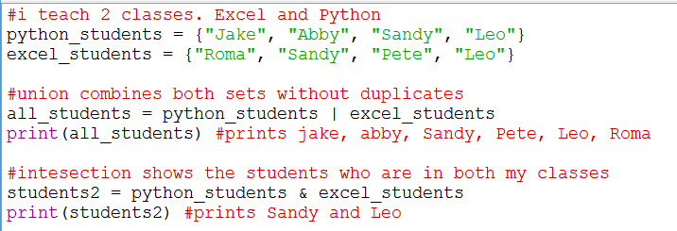
Set Notations
Notes:
#My call history has 100s of calls from the same few callers
#I want to know the unique names of the callers and remove duplicates
#call history is a list with len of 8
call_history = ["Mom", "Mom","Mom", "Mom","Dad", "Dad", "Pizza Hutt", "Free Vacation Scam"]
#converting call history from a list to a set
my_callers = set(call_history)
#printing set with len of 4
print(my_callers)

Slide 20
Review: Data Structures
Data Structure | Syntax | Ordered | Mutable | Allows duplicate values
List | l = [“eggs“, “milk”, “jello”] | Y | Y | Y
Tuple | t = (“eggs”, “milk”, “jello”) | Y | N | Y
Dictionary | d = {“eggs”:4, “milk”:2} | N | Y | Y*
Set | s = {“eggs”, “milk”, “jello”} | N | Y | N
Notes:
Review from powerpoint 2 slide 10

